Slide 1



Dynamic Sign Language Synthesis
IOMP IT-25-06
Supervisor : Dr. U. Chaitanya
Assistant Professor - Dept IT
Krithi. ch - 22261A1236
Satvik Dabbara - 22261A1217

Slide 2
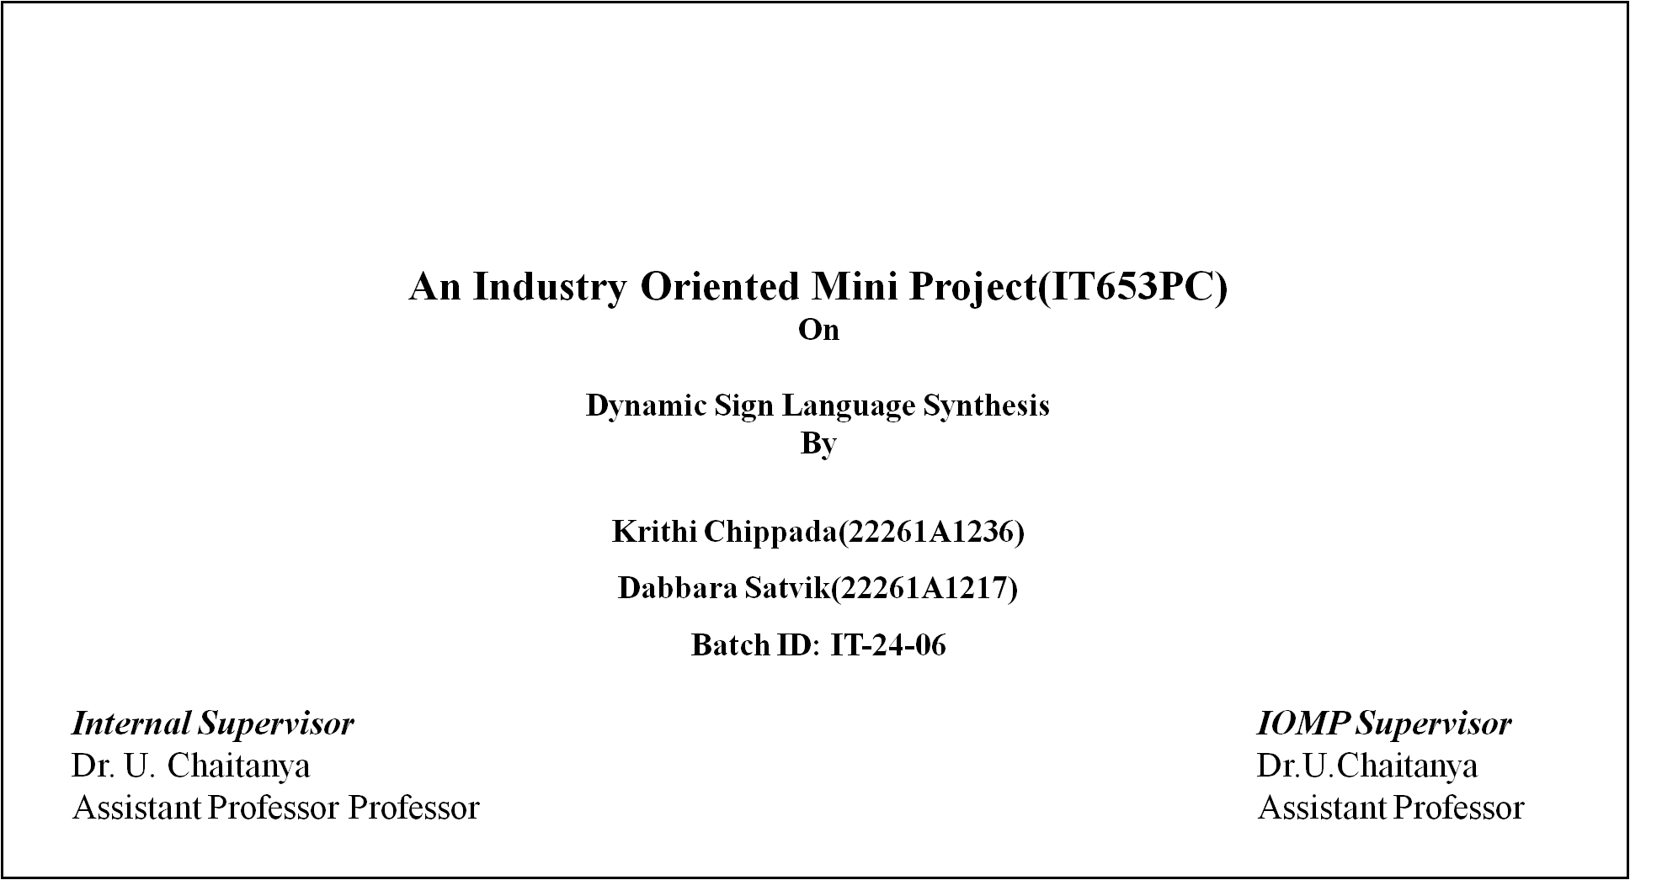

MAHATMA GANDHI INSTITUTE OF TECHNOLOGY(A)
DEPARTMENT OF INFORMATION TECHNOLOGY

Slide 3
Index
Abstract
Introduction
Existing System
Proposed System
Application
Requirements
Literature Survey
Problem Statement
Objective of Project
Modules Description
Algorithm/Model/
Design
13. Test Cases
14. Conclusion and Future Enhancement
15. References

Slide 4
Abstract
Sign language is necessary for Deaf and Hard-of-Hearing (DHH) community communication. The existing sign language systems uses static signs or pre-recorded animated signs, which do not have the natural movement of actual signing.
The objective of this project is to create a real-time system that translates multimodal inputs including spoken, and text inputs into synchronized and dynamic sign language animations. It automatically detects the language of input, converts it to English text, and produces realistic sign language by using technologies like Deep Learning, speech recognition technology, natural language processing (NLP), and computer vision technology.
A key feature is its ability to maintain synchronization between the original input and the generated signing, preserving the natural flow of communication. This software helps reduce communication gaps and promotes accessibility for the DHH community online.

Slide 5
Introduction
Why Do We Use Sign Language?
Sign language is the main means of communication for the Deaf and Hard-of-Hearing (DHH) population.
It enables successful communication of ideas, emotions, and thoughts without the use of words.
Sign language improves access to education, the workplace, and everyday life.
Characteristics of Sign Language
Visual & Gesture-Based
Non-Universal
Grammar & Syntax
Expressive & Dynamic

Slide 6
Existing Systems
Requires manual switching between human signers, reducing automation.
Uses fixed sign videos, lacking flexibility for dynamic content.
Processes input only offline, limiting real-time interaction.
Fails to sync signs accurately with spoken or written input.
Supports only a few languages, reducing accessibility.
Cannot process text and audio inputs together.
Lacks facial expressions and gestures, reducing sign clarity.

Slide 7
Proposed Systems
Processes input from text and audio in real time.
Detects the input language automatically without manual selection.
Generates dynamic sign animations tailored to the input content.
Synchronizes sign output accurately with the original input.
Enhances communication, especially in online or real-time scenarios.

Slide 8
Applications
Online Education Platforms
Video Translations
Public Announcements & Emergency Broadcasts
Healthcare Interactions
Government and Legal Services
Customer Service and Help Desks
Workplace Communication
Web Content and Tutorials

Slide 9
Requirements
Software Requirements
Hardware Requirements
Programming Language - Python
Front-end - HTML, CSS, JavaScript
Back-end - Node js
Cloud - Firebase
Dataset - SignBank dataset
Image Processing Libraries - Open CV & OpenPose
Compact Language Detector - Language Identification
Pose Estimation - Open Pose, MediaPipe
Open AI Whisper - Speech Recognition
Intel I5 Processor
RAM size 64GB
Storage 256GB

Slide 10
Literature Survey
Sno. | Author & Year of Publication | Journal or Conference | Methodology/Algorithm or Techniques Used | Merits | Demerits | Research Gap
1 | Anant Kaulage, Ajinkya Walunj, Akash Bhandari, Aneesh Dighe, Anish Sagri (2024) | IEEE ICDSIS | Whisper model for STT; BERT, T5, TextRank for summarization; ConceptNet + BERT for Q&A; Multilingual translation; ISL support via NLP techniques | 95.12% accuracy in subtitle generation; 3.43% WER in STT; Multilingual translation, summarization, Q&A, ISL support | Lack of Public Dataset; Models may not generalize with Indian Language | Improve ISL automation; Extend to corporate/media platforms
2 | Vi N. T. Truong, Chuan-Kai Yang, Quoc-Viet Tran (2016) | IEEE GCCE | A Translator for ASL to Text and Speech; AdaBoost + Haar classifiers; Dataset: 28,000 positive, 11,100 negative images | Recognizes static ASL alphabets; 98.7% precision; Real-time video to text/speech | Recognizes static ASL alphabets only | Extend to dynamic gestures and other languages; Add grammar-aware sentence formation
3 | Lipisha Chaudhary, Tejaswini Ananthanarayana, Enjamamul Hoq, Ifeoma Nwogu (2022) | IEEE TPAMI | Dual Transformer Networks; Metric embedding for sign similarity; Cross-feature fusion; Keypoint-based pose inputs; BLEU score evaluation | Two-way transformer translation; Metric embedding based on sign similarity | Focused only on GSL; Computationally expensive; No facial/gesture nuance | Extend to more sign languages; Avatar-based output; Train with diverse signers; Real-time deployment

Slide 11
Navroz Kaur Kahlon, Williamjeet Singh (2021) | Springer | Literature review across 148 studies; Classified techniques: statistical, neural, hybrid; Survey of evaluation metrics and generation techniques | Reviewed 148 studies; Classified translation approaches; Manual vs. automatic evaluation | Classified translation approaches; Manual vs. automatic evaluation | Use deep learning for translation; Standardize evaluation metrics; Improve sign clarity; Develop end-to-end systems
Hao Zhou et al. (2024) | ACM IoTDI | Meta-learning approach; Data from 14 native users; Avoided synthetic data; Vocabulary of 1057 | Meta-learning-based wearable ASL recognition; Achieved 26.9% WER; Avoided flaws of virtual data | 26.9% WER is relatively high; Limited to ASL; No multilingual support | Support continuous signing; Include gestures and facial cues

Slide 12
Problem Statement
Deaf and Hard-of-Hearing (DHH) people have profound communication challenges in their day-to-day lives because no accessible, real-time sign language translation systems are available.
Current equipment heavily depends on static signs or pre-recorded animations, which cannot capture the fluidity, contextual information, or expressiveness of natural sign language. Most equipment is also restricted to one format of input (often text) and cannot translate spoken or video input in real time. This leads to limited access to education, healthcare, public services, and online content for the DHH community.
There is a need for a dynamic, real-time, and multimodal solution that can fill this communication gap by converting spoken, and text inputs into synchronized, Sign language

Slide 13
Objective of our Project
To create a real-time system that translates text and audio inputs into sign language animations.
To create dynamic and realistic sign language animations that mimic natural human signing.
To provide synchronization between the original input and the sign output, maintaining the natural flow of conversation.

Slide 14
Modules Description
Signed to Spoken translation pipeline
a. Speech Recognition and Speech-to-Text
Utilizes Automatic Speech Recognition (ASR) to convert spoken language audio into text.
Employs models like WhisperX for accurate transcription.​
b. Text to Sign Language Notation (Glosses)
Translates text into glosses using methods such as:
Simple lemmatization.
SpaCy-based lemmatization.
Rule-based word reordering.
Neural Machine Translation (NMT).

Slide 15
c. Gloss to Pose Sequence
Maps glosses to pose sequences by:
Looking up each gloss in a lexicon of sign language videos.
Extracting and concatenating corresponding skeletal poses.​
d. Pose to Video Animation
Generates sign language videos from pose sequences using image translation models like Pix2Pix.

Slide 16
Algorithm/Method/Model
1. Spoken to Signed Translation Pipeline
a. Speech Recognition and Speech-to-Text
WhisperX (Automatic Speech Recognition)​
b. Text to Sign Language Notation (Glosses)
Simple Lemmatizer
SpaCy Lemmatizer
Rule-based Word Reordering and Dropping
Neural Machine Translation (NMT)​
c. Gloss to Pose Sequence
Method: Lexicon Lookup and Pose Concatenation​
d. Pose to Video Animation
Image Translation Model (Pix2Pix)​

Slide 17
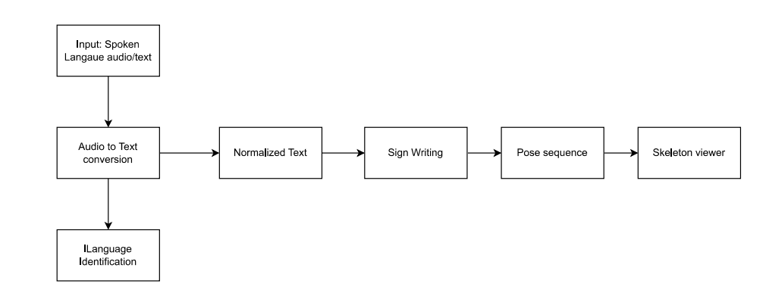
Design
Architecture of Dynamic Sign Language Synthesis
This diagram represents the architecture of a Spoken-to-Signed Language Translation System that transforms spoken audio input into a visual sign language output using a multimodal pipeline.

Slide 18
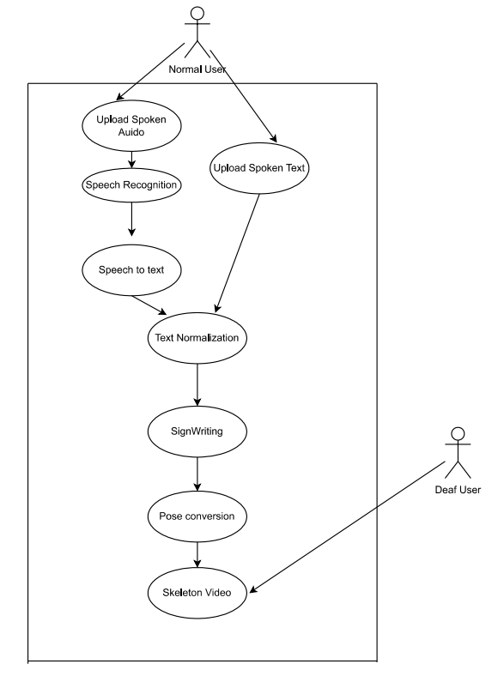
UML DIAGRAMS
Use Case Diagram
This use case diagram shows how a Normal User provides audio or text input, which is converted into sign language. The system generates a skeleton video that is viewed by the Deaf User.

Slide 19
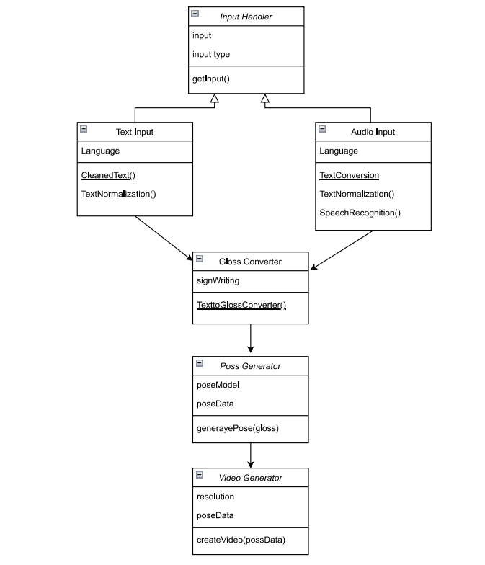
Class Diagram
This class diagram shows the object-oriented design of the spoken-to-sign translation system. It includes classes for input handling, text and audio processing, gloss conversion, pose generation, and video generation. Inheritance and method definitions illustrate the structured data flow and modular architecture of the translation pipeline

Slide 20
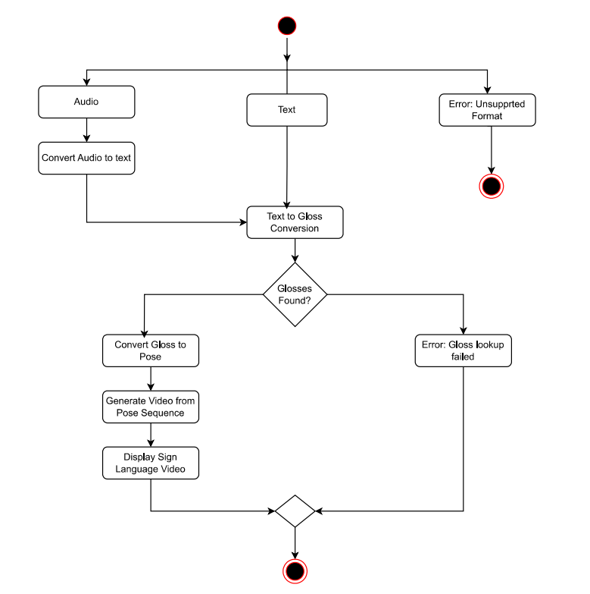
Activity Diagram
This activity diagram is a variation of the earlier architecture diagram (Figure 3.2.2), enhanced with visual markers for start and end points. It represents the spoken-to-signed translation process from input to video output, including branches for error handling. The red-circled nodes mark system start and termination points.

Slide 21
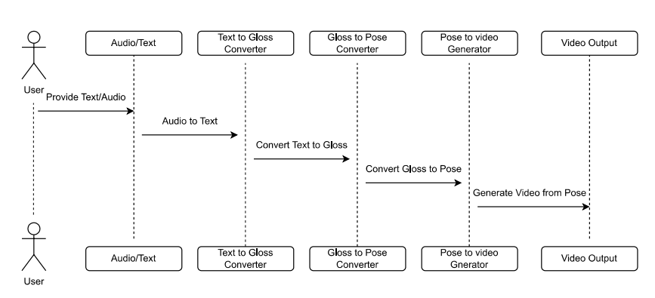
Sequence Diagram
This sequence diagram depicts the chronological interaction among system components involved in converting text or audio to sign language video. It illustrates how a user provides input, which flows through modules for audio-to-text conversion, text-to-gloss translation, gloss-to-pose transformation, and final video rendering, before being output back to the user.

Slide 22
Test Cases
Test Case ID | Test Case Name | Test Case Description | Expected Output | Actual Output | Remarks
TC01 | Speech-to-Text Conversion | Check if audio input is correctly converted to English text using Whisper. | Text matches spoken input accurately. | Text matches spoken input accurately. | Success
TC02 | Text Normalization | Check if input text is cleaned and normalized before gloss conversion. | Output is cleaned of punctuation and normalized. | Output is cleaned of punctuation and normalized. | Success
TC03 | Text-to-Gloss Conversion | Verify conversion of normalized text to correct gloss representation. | Correct sign language gloss generated. | Correct sign language gloss generated. | Success
TC04 | Gloss-to-Pose Generation | Check if gloss is accurately converted to pose keypoints using the pose model. | Sequence of poses representing the gloss. | Sequence of poses representing the gloss. | Success
TC05 | Pose-to-Video Rendering | Verify pose sequence is converted into skeletal animation video. | Accurate animation matching input gloss. | Accurate animation matching input gloss. | Success
TC06 | End-to-End Flow (Audio) | Test complete pipeline from audio to ASL video output. | Sign language animation corresponds to input speech. | Sign language animation corresponds to input speech. | Success
TC07 | End-to-End Flow (Text) | Test complete pipeline from text to ASL video output. | Sign language animation corresponds to input text. | Sign language animation corresponds to input text. | Success

Slide 23
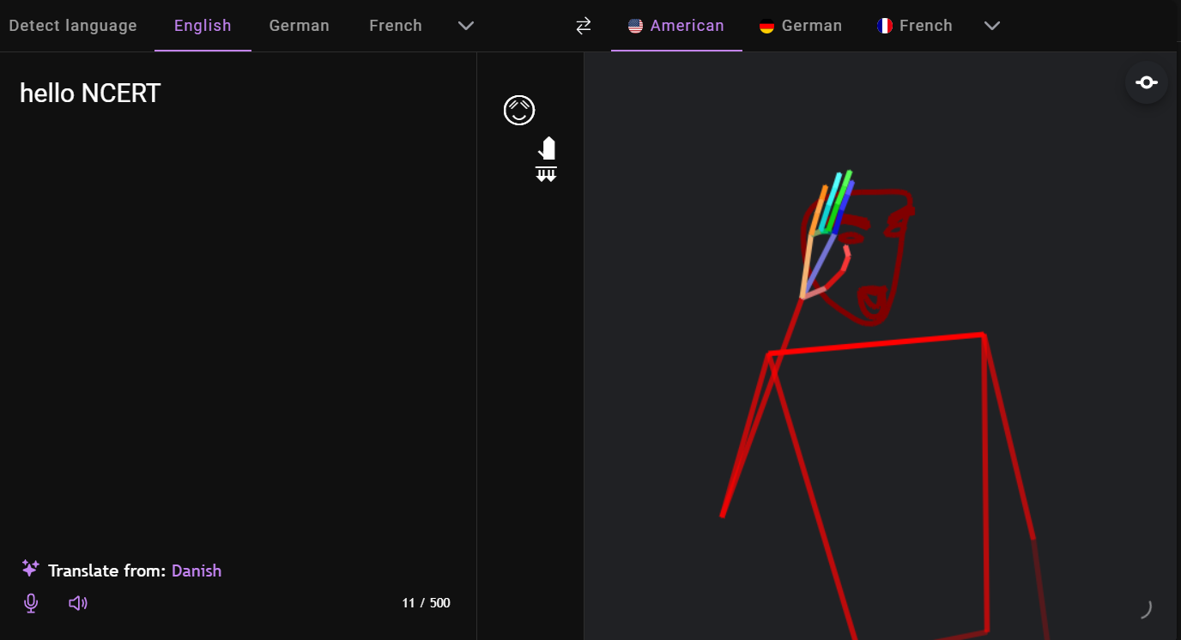
Result
Input: Text

Slide 24
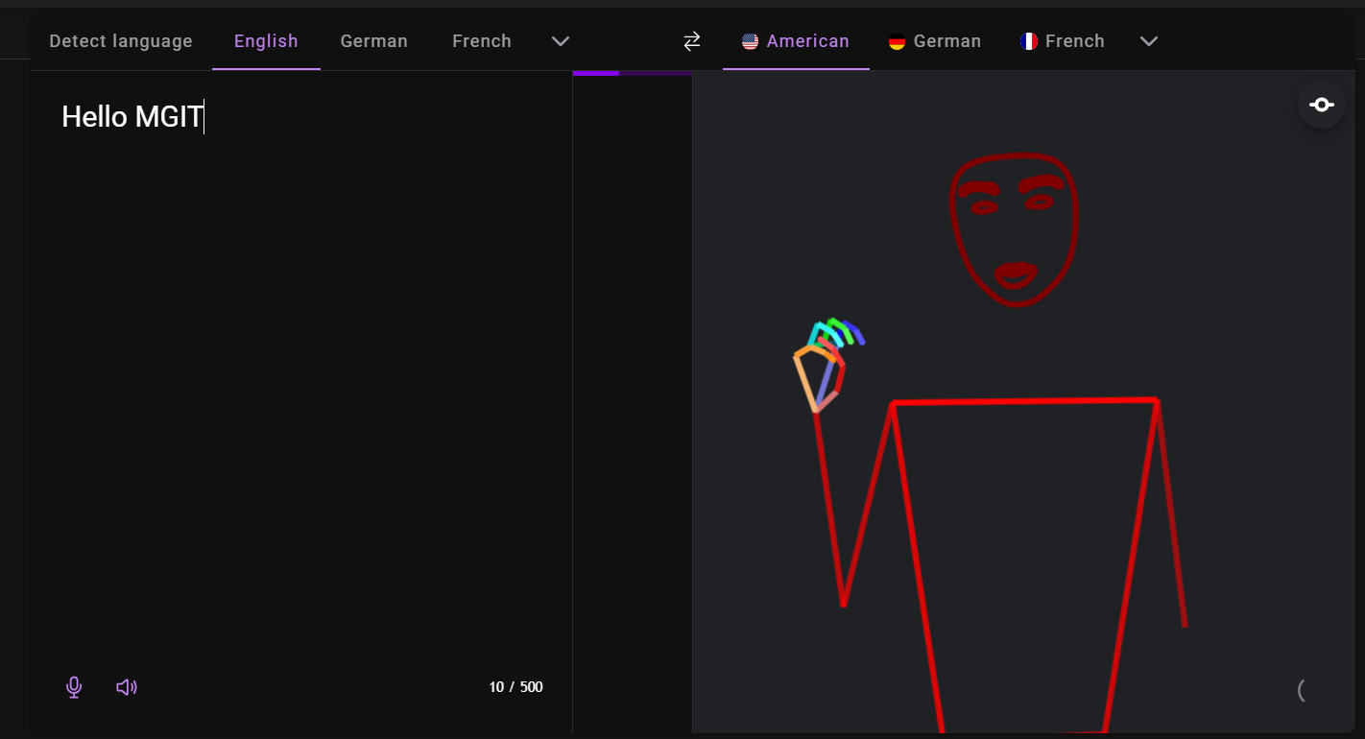
Result
Input: Audio

Slide 25
Conclusion
Developed a real-time spoken-to-signed language translation system for DHH users
Supports both text and speech input
Uses ASR, gloss generation, pose estimation, and avatar-based animation
Produces expressive, synchronized sign output with gestures, facial expressions, and posture
Dynamic and scalable — adaptable for multiple sign languages
Modular architecture allows easy integration into assistive tools and platforms

Slide 26
Future Enhancements
Emotion Detection: Add sentiment analysis to capture tone for expressive signing
Multilingual Support: Extend to other sign languages like ISL and GSL
User Personalization: Customize avatar appearance and signing style
Feedback Integration: Use user input to refine accuracy and experien

Slide 27
References
[1] A. Kaulage, A. Walunj, A. Bhandari, A. Dighe and A. Sagri, "Edu-lingo: A Unified NLP Video System with Comprehensive Multilingual Subtitles," 2024 Second International Conference on Data Science and Information System (ICDSIS), Hassan, India, 2024, pp. 1-8, doi: 10.1109/ICDSIS61070.2024.10594128
[2] V. N. T. Truong, C. -K. Yang and Q. -V. Tran, "A translator for American sign language to text and speech," 2016 IEEE 5th Global Conference on Consumer Electronics, Kyoto, Japan, 2016, pp. 1-2, doi: 10.1109/GCCE.2016.7800427
[3] L. Chaudhary, T. Ananthanarayana, E. Hoq and I. Nwogu, "SignNet II: A Transformer-Based Two-Way Sign Language Translation Model," in IEEE Transactions on Pattern Analysis and Machine Intelligence, vol. 45, no. 11, pp. 12896-12907, 1 Nov. 2023, doi: 10.1109/TPAMI.2022.3232389
.

Slide 28
References
[4] N. K. Kahlon and W. Singh, "Machine translation from text to sign language: a systematic review," Springer-Verlag, 2021. DOI: https://doi.org/10.1007/s10209-021-00823-1.
[5] Hao Zhou, Taiting Lu, Kennath Dehaan, Mahanth Gowda “ASLRing: American Sign Language Recognition with Meta-Learning on Wearables” 2015 International Conference on Pervasive Computing (ICPC) DOI https://doi.org/10.1109/IoTDI61053.2024.00022
[6] A. Moryossef, "sign.mt: Real-Time Multilingual Sign Language Translation Application," arXiv preprint arXiv:2310.05064, 2024.

Slide 29
Thank You
Execution Video

